Slide 1
هوش محاسباتی:
منطق فازی
دانشكده مهندسي كامپيوتر
دانشگاه علم و صنعت ايران
ناصر مزيني mozayani@iust.ac.ir
ریاضیات فازی

Slide 2
Extension principle
Means :extending mathematical concepts and algebraic operations to fuzzy sets
  Lotfi zadeh (1965): first introduction in an elementary form
  Lotfi zadeh(1973), Dubois & Prade(1980) : modifications

Slide 3
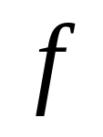
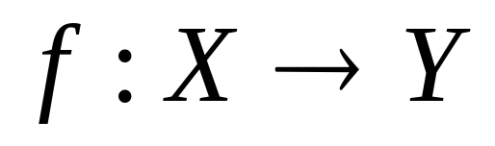
Extension principle (cont.)
A classical function
X
Y
(domain =X)

Slide 4
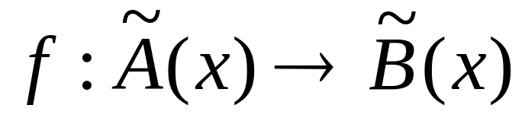
Extension principle (cont.)
Extending function to fuzzy sets
X
Y
(domain =F(X)
a set of fuzzy subsets of X)

Slide 5

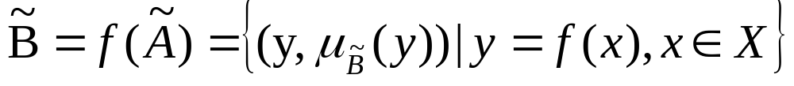
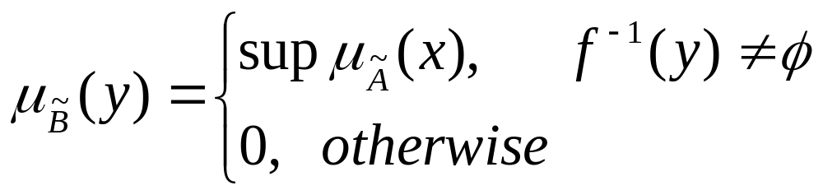
Extension principle (cont.)
Definition 1 : f:X→Y and is a fuzzy subset of X
example 1 : suppose X=Z, y=f(x)=x*x

Slide 6

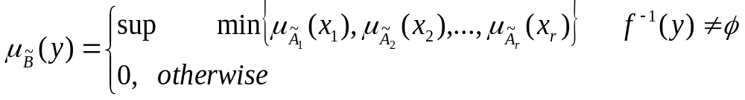
Extension principle (cont.)
Definition 2 :
let X be a cartesian product of r universe sets
we define a fuzzy set so that:

Slide 7

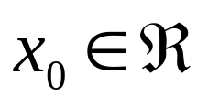
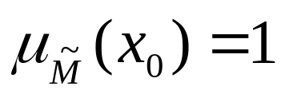
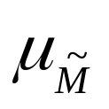
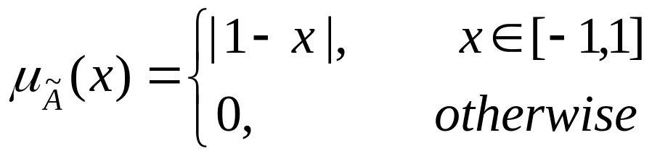
Fuzzy numbers
An application of extension principle:
  Extending algebraic operations to fuzzy numbers
Definition:
A fuzzy number is a convex normalized fuzzy set of the real domain
Such that:
1- It exists exactly one with
2- is piecewise continuous
Example:
an “approximately zero” fuzzy number:

Slide 8
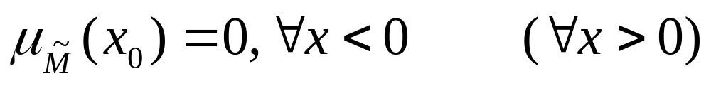
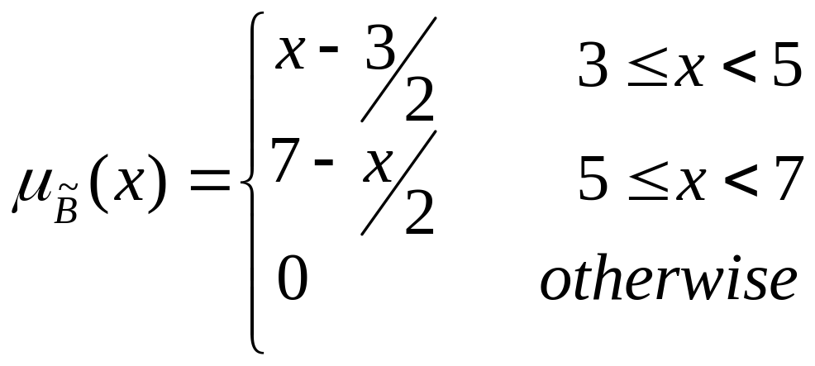
Fuzzy numbers (cont.)
A positive (negative) fuzzy number:
Example3:
an “approximately five” fuzzy number:

Slide 9
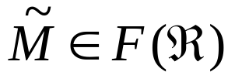
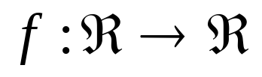
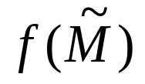
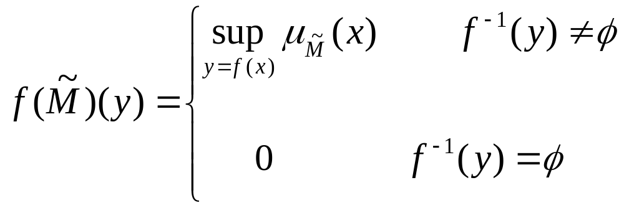
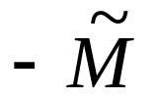
Fuzzy numbers (cont.)
Definition:
suppose and ,
a fuzzy number is defined such as:
What is the symmetric fuzzy number ?

Slide 10
Fuzzy numbers (cont.)
A binary operation * in R is called increasing (decreasing) if
for x1>y1 and x2>y2
Example4:
f(x,y)=x+y increasing
f(x,y)=x.y increasing on R⁺
f(x,y)=-(x+y) decreasing

Slide 11
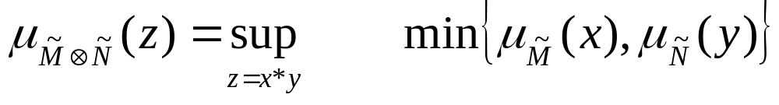
Fuzzy numbers (cont.)
Extending the normal algebraic operations
  Extended addition
  Extended subtraction
  Extended product
  Extended division
+
−
×
:
The symbol is denoted in a circle
Condition :
Continuous and surjective MBF with a continuous, increasing
binary operation
Properties of extended operation: Commutative, associative

Slide 12
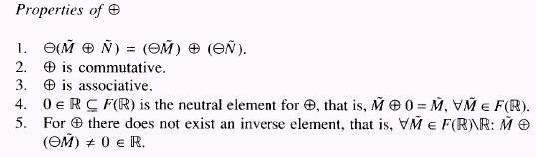
Fuzzy numbers (cont.)
--»Variables can not be eliminated !

Slide 13


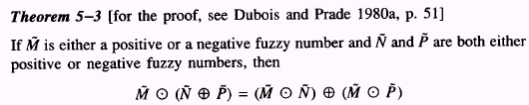
Fuzzy numbers (cont.)

Slide 14
Fuzzy numbers (cont.)
Subtraction ?
Division?
(neither increasing nor decreasing)
→ Previous theorem is not applicable
But:
extended subtraction can be written in an extended addition form
extended division can be written in an extended product form

Slide 15

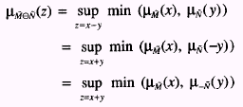
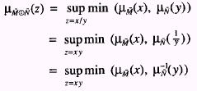
Fuzzy numbers (cont.)
Extended subtraction:
Extended division:

Slide 16
Fuzzy numbers (cont.)
Example:
-“approximately FIVE”
-“approximately SEVEN”
-6 -4 -2 0 2 4 6 8 10 12 14 16

Slide 17
Fuzzy numbers (cont.)
-A fuzzy interval (trapezoidal)
0 1 2 3 4 5 6 7
-a fuzzy number (triangular)
can be a special case
0 1 2 3 4 5 6 7

Slide 18

LR fuzzy numbers
- A special type of representation for fuzzy numbers (Dubois & Prade, 1979)
A special definition for MBF
Computational efficiency

Slide 19

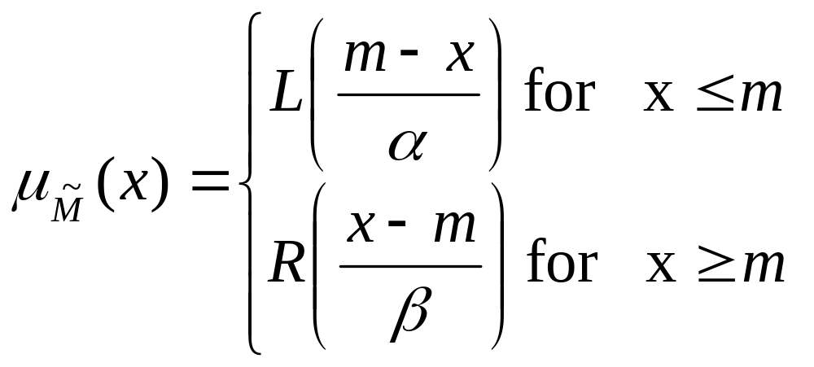
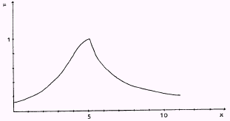
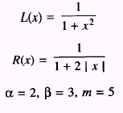
LR fuzzy numbers
example

Slide 20
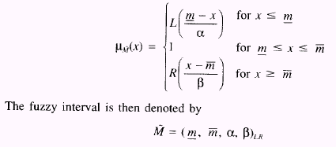
LR fuzzy numbers
A fuzzy interval :
If m is not a real number but an interval

Slide 21
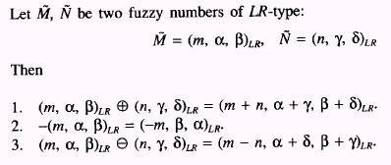
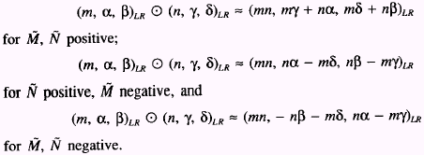
LR fuzzy numbers

